Slide 1
Silicon Soul: Neural Synthesis as Archive-Specific Compositional Tool in Orchestral Music
Robert Laidlow

Slide 2
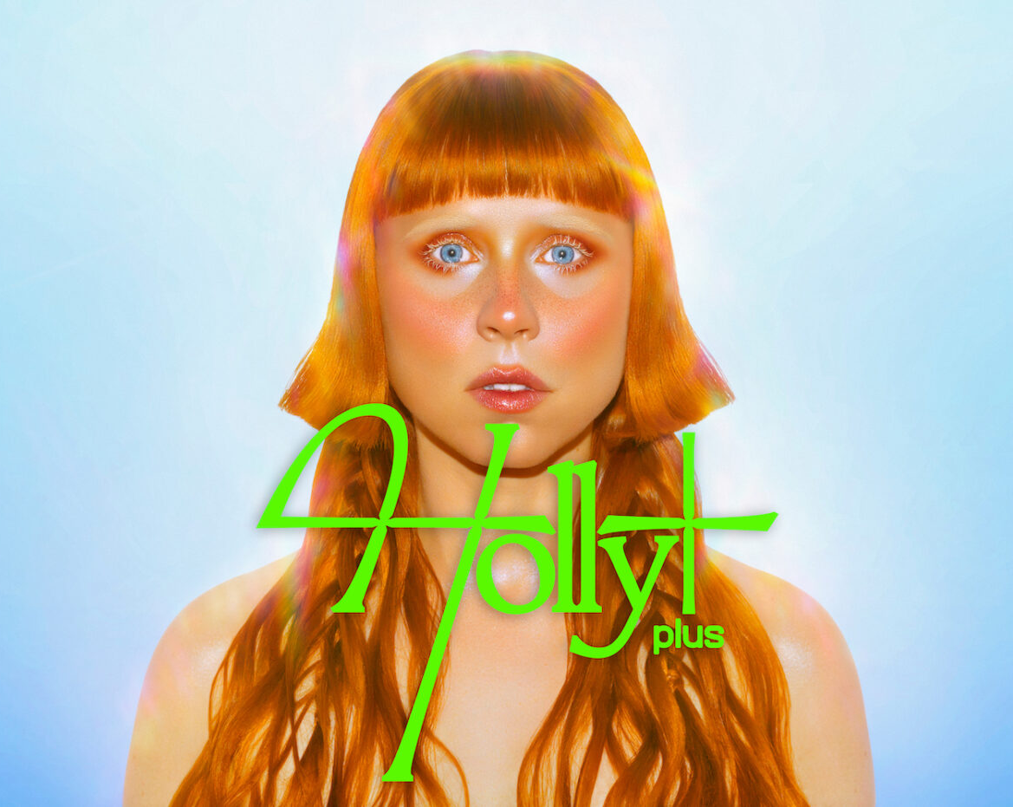
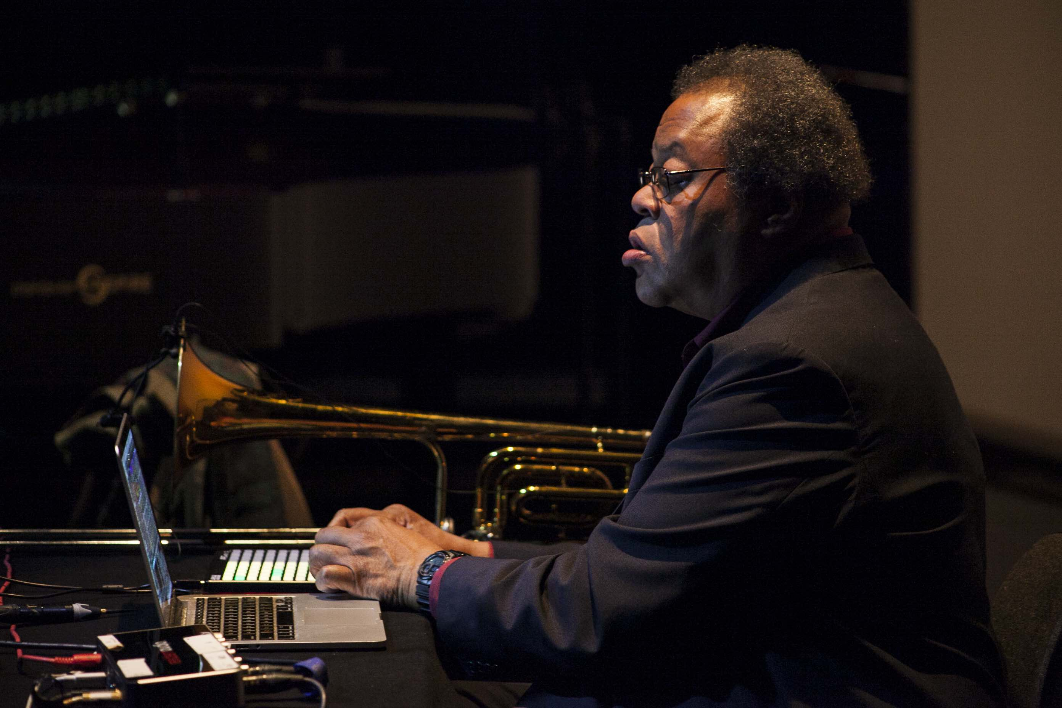
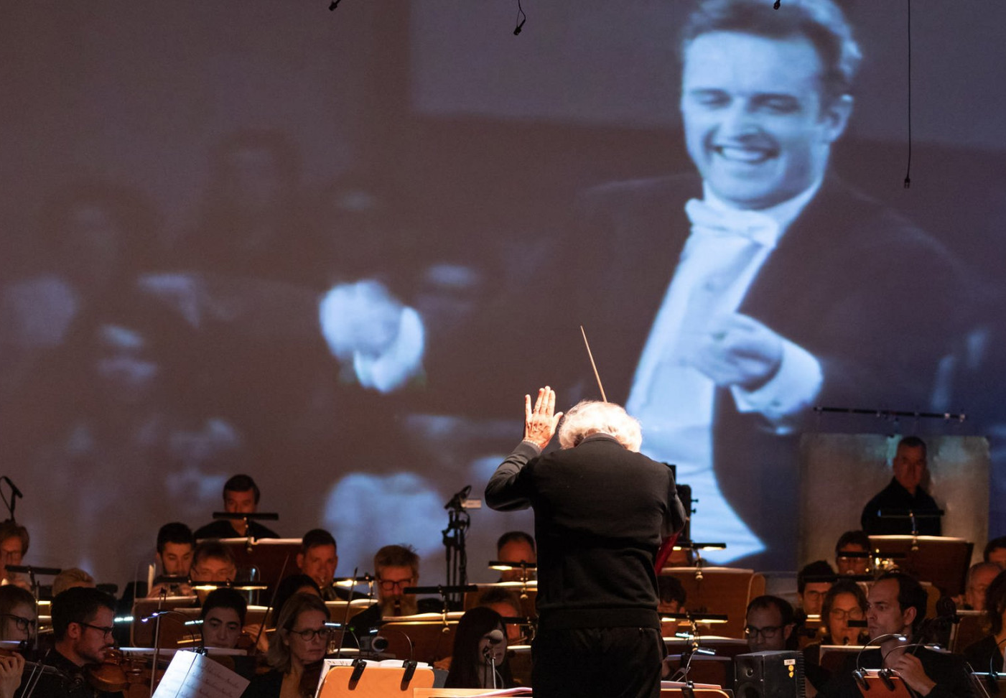
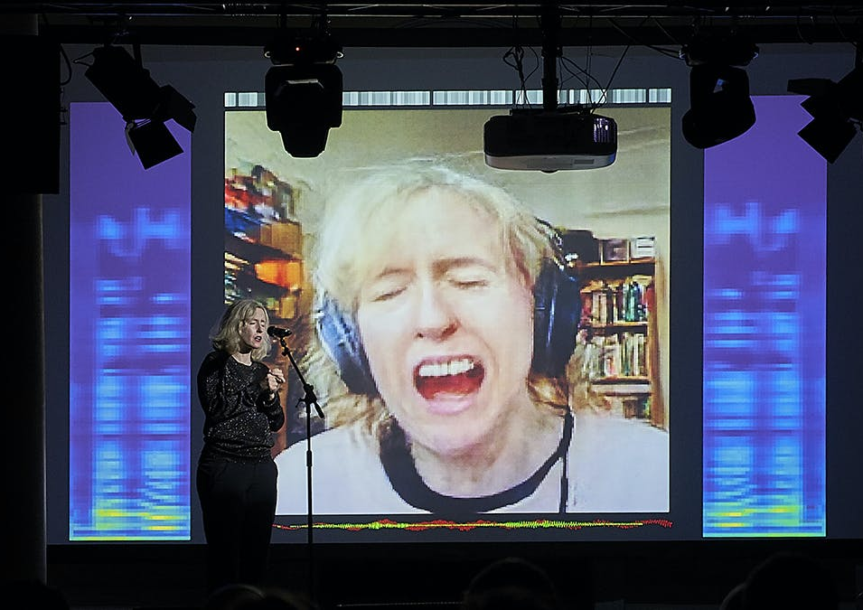
Introduction
My background
PhD: “Artificial Intelligence Within the Creative Process of Contemporary Classical Music”
“Soul” – Movement III of “Silicon”
My Personal Dataset
Lots of modern orchestral music
George Lewis: Voyager, Forager, etc
Simon Steen-Andersen: archives
Holly Herndon (Holly+) & Jennifer Walshe (ULTRACHUNK): imperfect mirroring

Slide 3
“Solvability” & “Datafication”
MusicLM & Neural Synthesis
Is music a problem to be solved?
Even assuming it is, how is the problem being solved?
Does data capture what a musical performance is?
If not, what is left that data does not capture?

Slide 4
Aims
Explore “datafication” and “solvability” in the context of a live orchestral performance
Create an imperfect mirror of the orchestra – what does this sound like?
Explore the relationship between an orchestra and its imperfect mirror
Treat AI as extremely specific tool, rather than monolithic force
Use neural synthesis to grant new “aspect” on a place, group, or idea
TOOLS
Neural Synthesis (PRiSM SampleRNN)
BBC Philharmonic broadcast archive
BBC Philharmonic forces

Slide 5
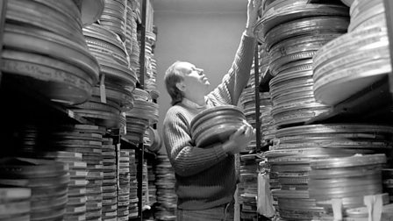
Archives
Why archives?
The Future and the Past in AI research
Can AI use an archive to hallucinate new histories?
Will AI focus on unexpected corners of an archive?
Technical challenge for PRiSM SampleRNN

Slide 6
Training on the BBC Phil Archive
Getting hold of the archive…
~2500 hour dataset
Test runs
Final run: 7 epochs – 36 hours per epoch
Presenter-only (4-5 hour dataset)

Slide 7
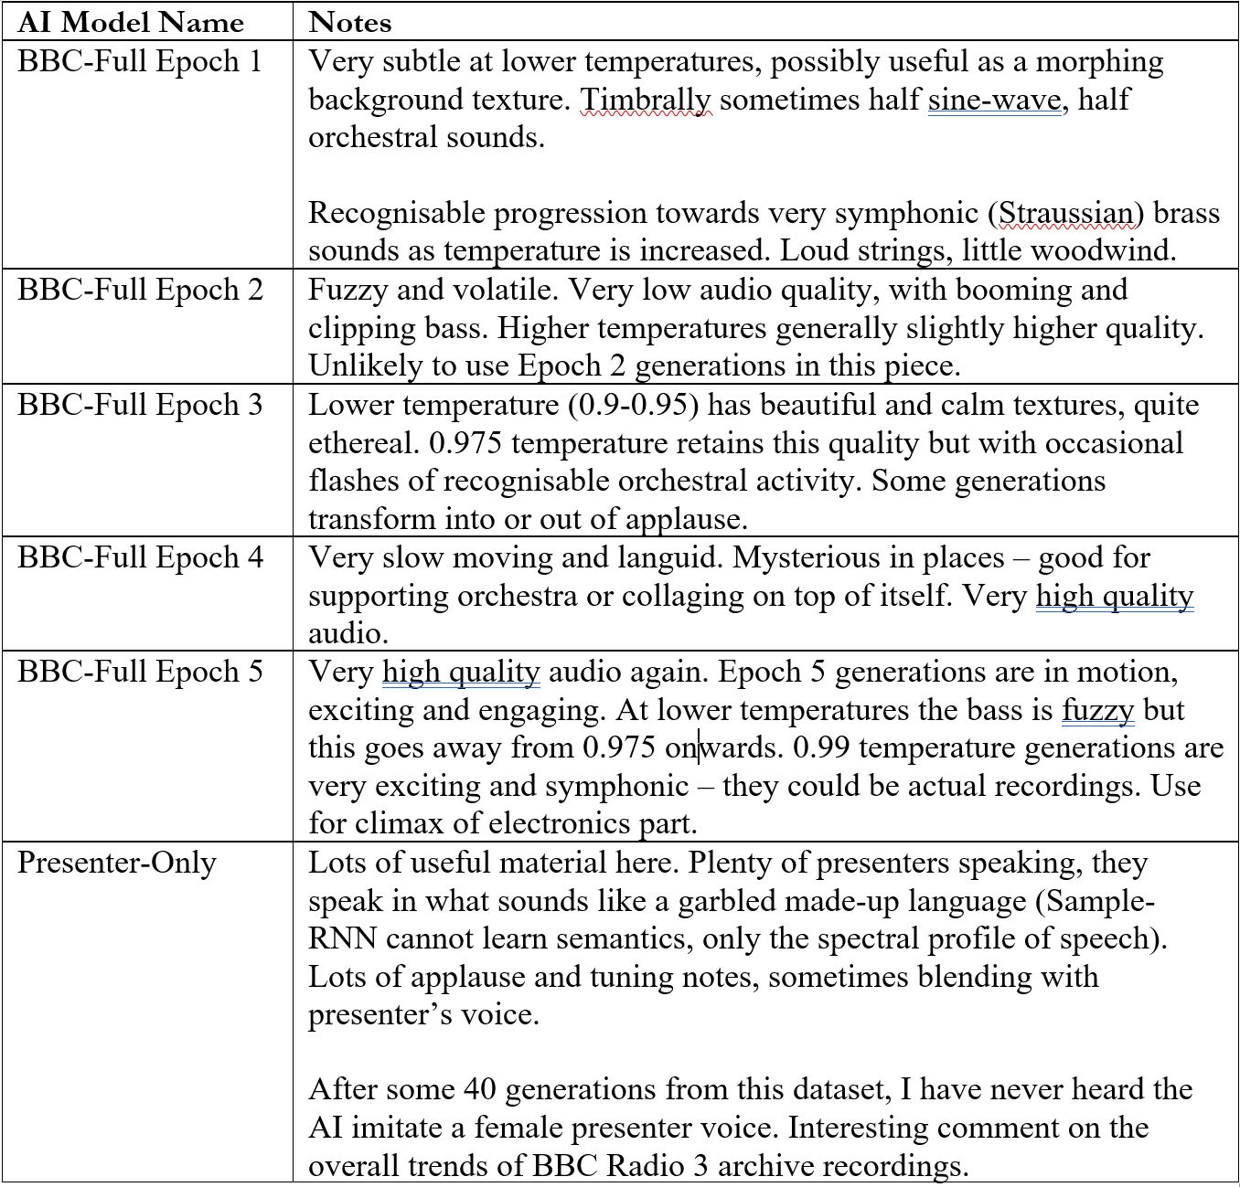
PRiSM SampleRNN Results
7 epochs (5 usable)
Each has its own fingerprint
Unsupervised learning and unconditional generation
Created 4-channel electronics track

Slide 8
Writing the Piece
Imitation and divergence (insider and outsider)
Orchestra performing “essence”

Slide 9
Writing the Piece
Orchestra as phantasm of performance
Structured, roughly, as two simultaneous journeys that intersect but don’t complete one another

Slide 10
Next Steps?
More types of archive:
“Content” for Saxophone and Electronics - Building my own archive using sounds from across the Internet
“Post-Singularity Songs” for Soprano and Electronics - Neural synthesis on archive of one performer
New piece for next year – using audio-visual archive
Interacting with the model live
Co-create with other composers using the same archive

Slide 11
Thanks for listening!
Robert.laidlow@jesus.ox.ac.uk
Twitter.com/Robert_laidlow

